Slide 1
System Identification to support Flight Test activities
23.02.2018
A project proposal
Alejandro Valverde
Notes:
For those of you already initiated in this topic, I would like to implement System ID techniques into the current Flight Testing methodology. I would do this in a:
Cost effective,
Efficient, and
Accurate,
ways. And in this presentation, I will describe how I want to do this.
Now, for those of you not initiated in this topic…

Slide 2
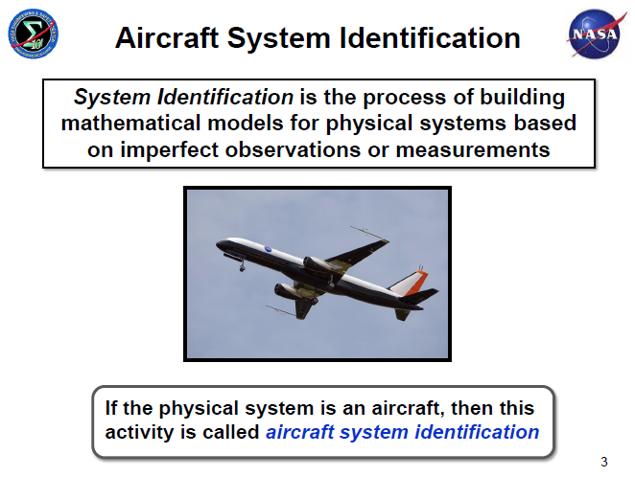
Aircraft System Identification
@ Kopter Group AG | Alejandro Valverde

Slide 3
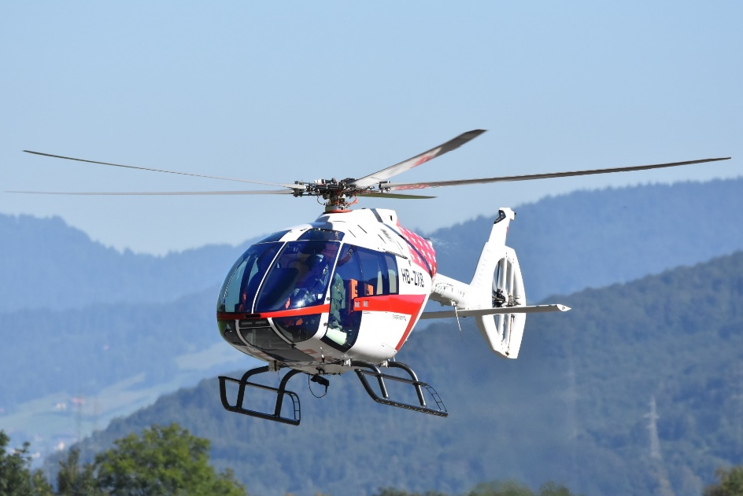
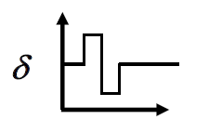
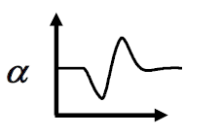
Problems in Aircraft Dynamics
Input, u
Output, z
System, S
Simulation: Given u and S, find z
Control: Given z and S, find u
Identification: Given z and u, find S
@ Kopter Group AG | Alejandro Valverde

Slide 4
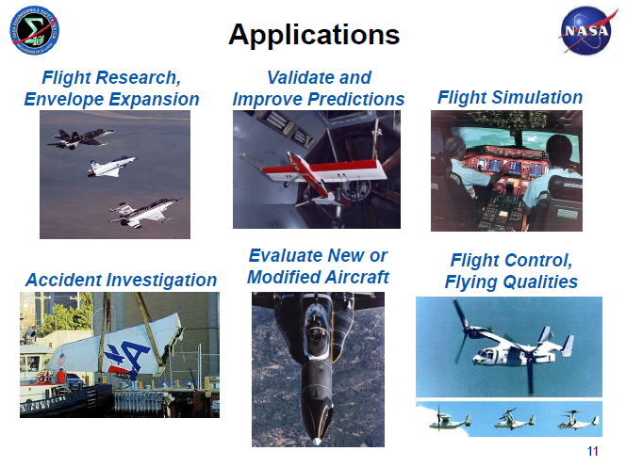
Applications of System ID techniques
@ Kopter Group AG | Alejandro Valverde

Slide 5
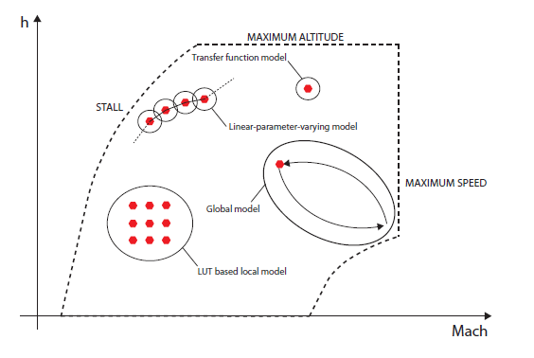
Motivations to the use System ID techniques
Verify and validate theoretical predictions for rotorcraft behaviour
Validate linearization of full helicopter dynamics from FlightLab and help development of FCS
Implement a FCS into FlightLab
Expansion of flight envelope for new aircraft
@ Kopter Group AG | Alejandro Valverde

Slide 6
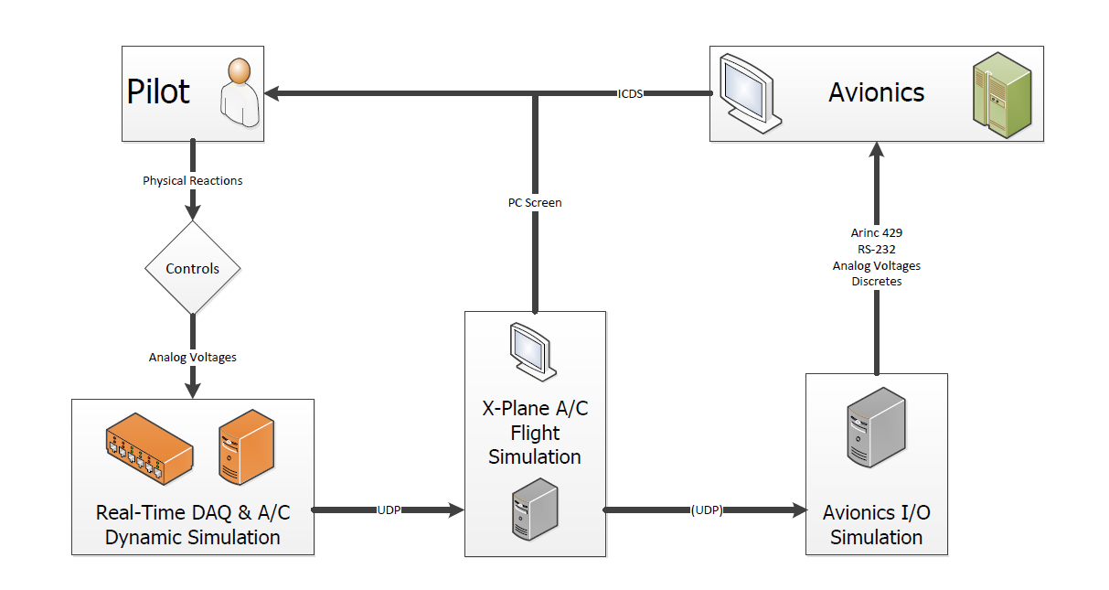
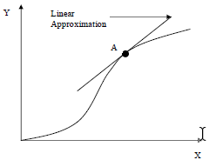

Aircraft Simulation – Current Kopter approach
Dynamic Simulation
Trimmed condition of FlightLab, e.g.:
Non-linear model
fwd level flight @ 100kts
Linear model
Extracted from Nicolas’ MSc Thesis overview in collaboration with Kopter Avionics Dep.
linearization of full H/C dynamics:
Suitable for:
$$\dot{x}=Ax+Bu$$
$$y=Cx+Du$$
FCS design
H/C flight simulation
Aircraft dynamic stability analysis
@ Kopter Group AG | Alejandro Valverde

Slide 7
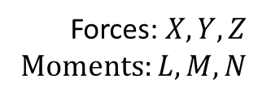
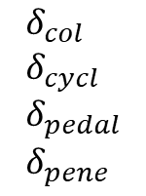
Aircraft Simulation – Current Kopter approach
Dynamic Simulation
Extracted from Nicolas’ MSc Thesis overview in collaboration with Kopter Avionics Dep.
$$δ_{col} \\ δ_{cycl} \\ δ_{pedal} \\ δ_{pene}$$
Pilot inputs
Aerodynamic H/C model
Equations of Motion
Forces: $X,Y,Z$ Moments: $L,M,N$
System ID provides an accurate, simple and reliable model of the H/C dynamics obtained from real flight test data of the real H/C
LUTs
@ Kopter Group AG | Alejandro Valverde
Notes:
Accurate -> Because it’s based on real flight data
Simple -> Does not require high computational power
Reliable -> Computed with

Slide 8
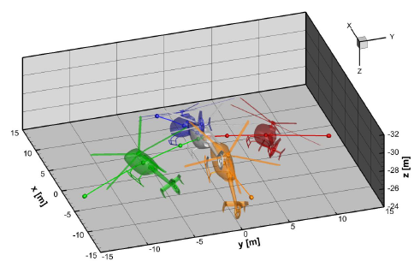
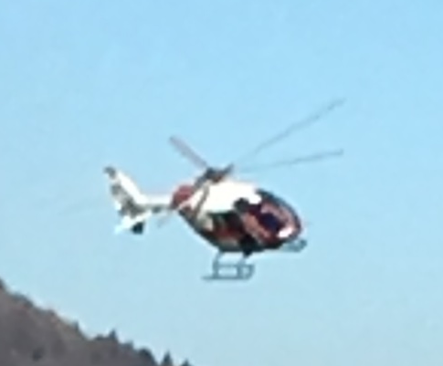
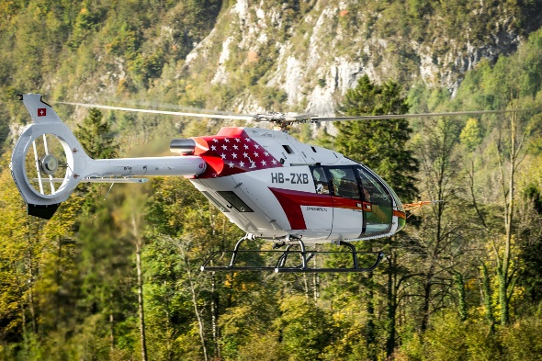
System ID R/C Model vs FlightLab
H/C model from System ID
FlightLab H/C model
Advantages:
High accuracy
Validation -> instantaneous
Non-linear flight dynamics
Drawbacks:
Depend on flight test data availability
Advantages:
Not dependency on flight test data
Drawbacks:
Validation -> complicated
Only linear flight dynamics
Best use: Dynamic model of the
real H/C
Best use: Loads prediction
@ Kopter Group AG | Alejandro Valverde

Slide 9
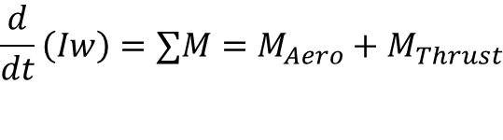
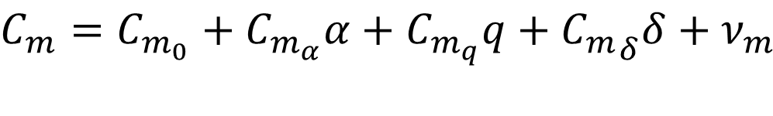
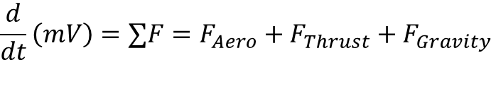
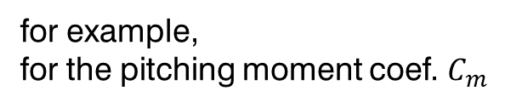


How does it work?
$$\frac{d}{dt}\left(mV\right)=∑F=F_{Aero}+F_{Thrust}+F_{Gravity}$$
Forces and moments
$$\frac{d}{dt}\left(Iw\right)=∑M=M_{Aero}+M_{Thrust}$$
$$F_{Aero}$$
Develop a model form from which parameters can be estimated using flight test data
$$M_{Aero}$$
for example,
for the pitching moment coef. $C_{m}$
longitudinal angular velocity
pitch control input
H/C angle of attack
$$C_{m}=C_{m_{0}}+C_{m_{α}}α+C_{m_{q}}q+{C_{m}}_{δ}δ+ν_{m}$$
pitching moment bias
static stability
dynamic stability (damping)
pitch control authority
@ Kopter Group AG | Alejandro Valverde

Slide 10
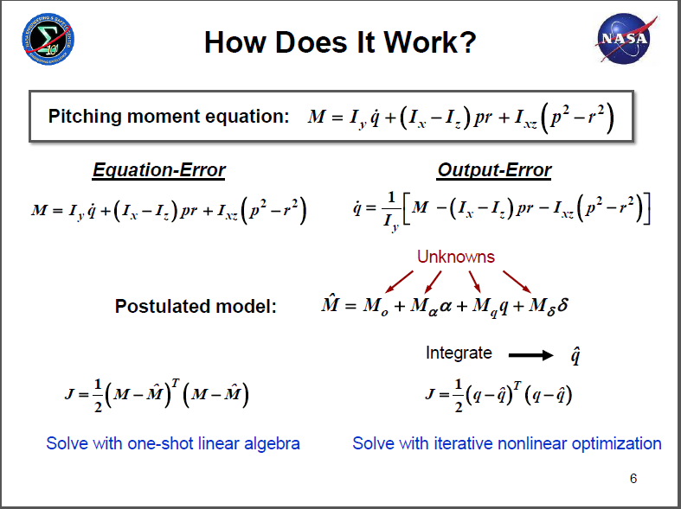
How does it work?
@ Kopter Group AG | Alejandro Valverde

Slide 11
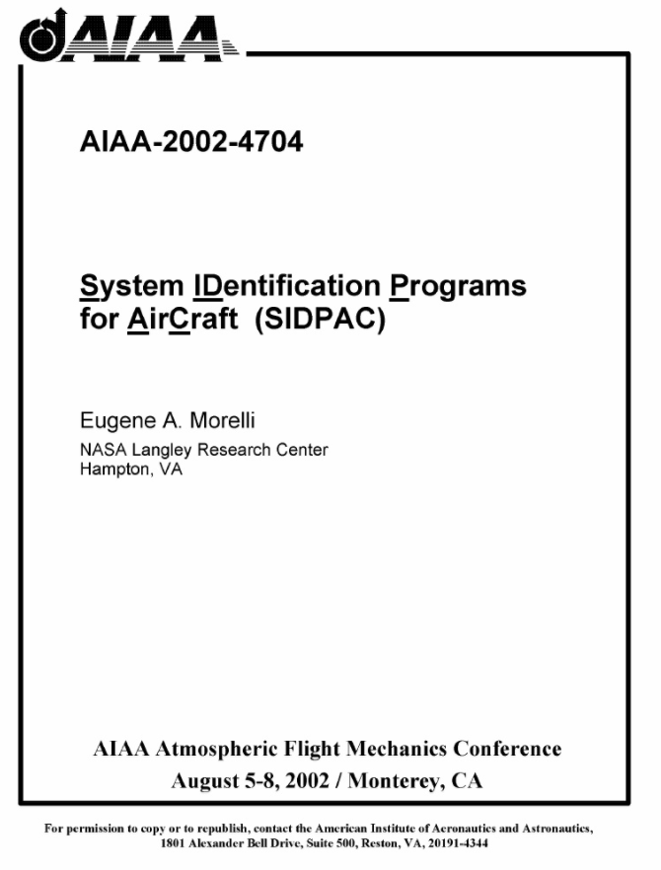
Tools
Already available
No development time needed
Proven industry suitable software
Further ways:
Python implementation
@ Kopter Group AG | Alejandro Valverde

Slide 12
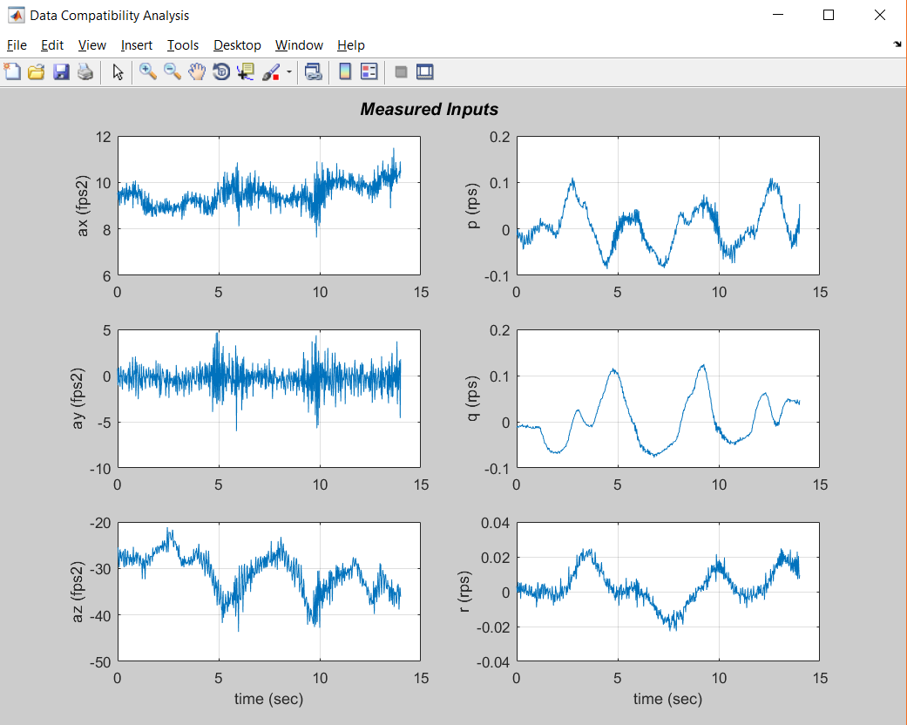
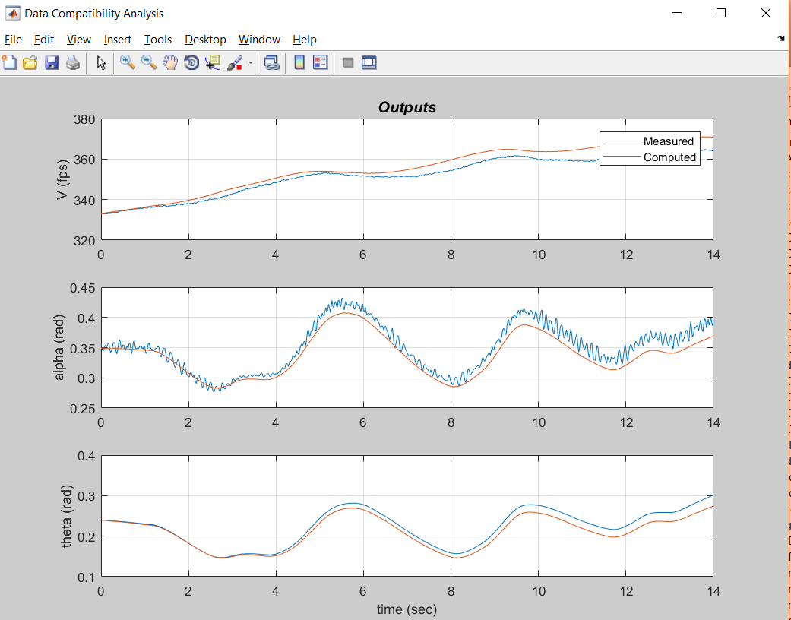

Slide 13
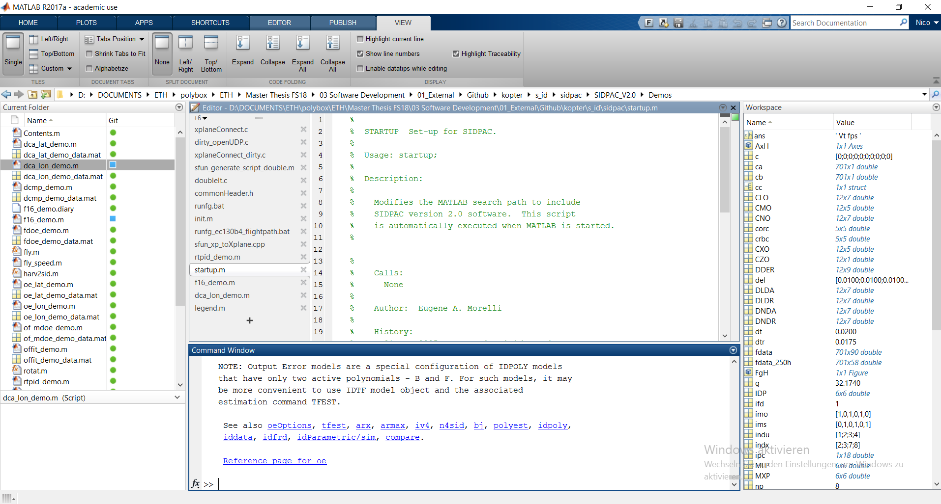

Slide 14
Why to introducing System ID into P3 test campaign?
To boost flight test productivity
Structure issues problems seem to be solved with P3, time to assess the handling qualities
Surely it will be need for PS4 and further developments after TC
Every big H/C DOA does it
Risk of not implementation¿?
Loss of time, hard to move forward in the flight envelope expansion
System ID takes time and money – but not nearly as much as not doing it Eugene A. Morelli NASA Langley Research Center Hampton
@ Kopter Group AG | Alejandro Valverde

Slide 15
What would I need?
A laptop
some accelerometers installed in P3, a part from the usual instrumentation…
Some coffee
@ Kopter Group AG | Alejandro Valverde

Slide 16
Why I can be the one doing this?
Dilemma, won’t hide it
Inexperience industrial <-> Passion
(but yes with System ID)
Kopter experience
Data analysis experience
Python
Matlab
Data analysis and machine learning techniques
@ Kopter Group AG | Alejandro Valverde

Slide 17
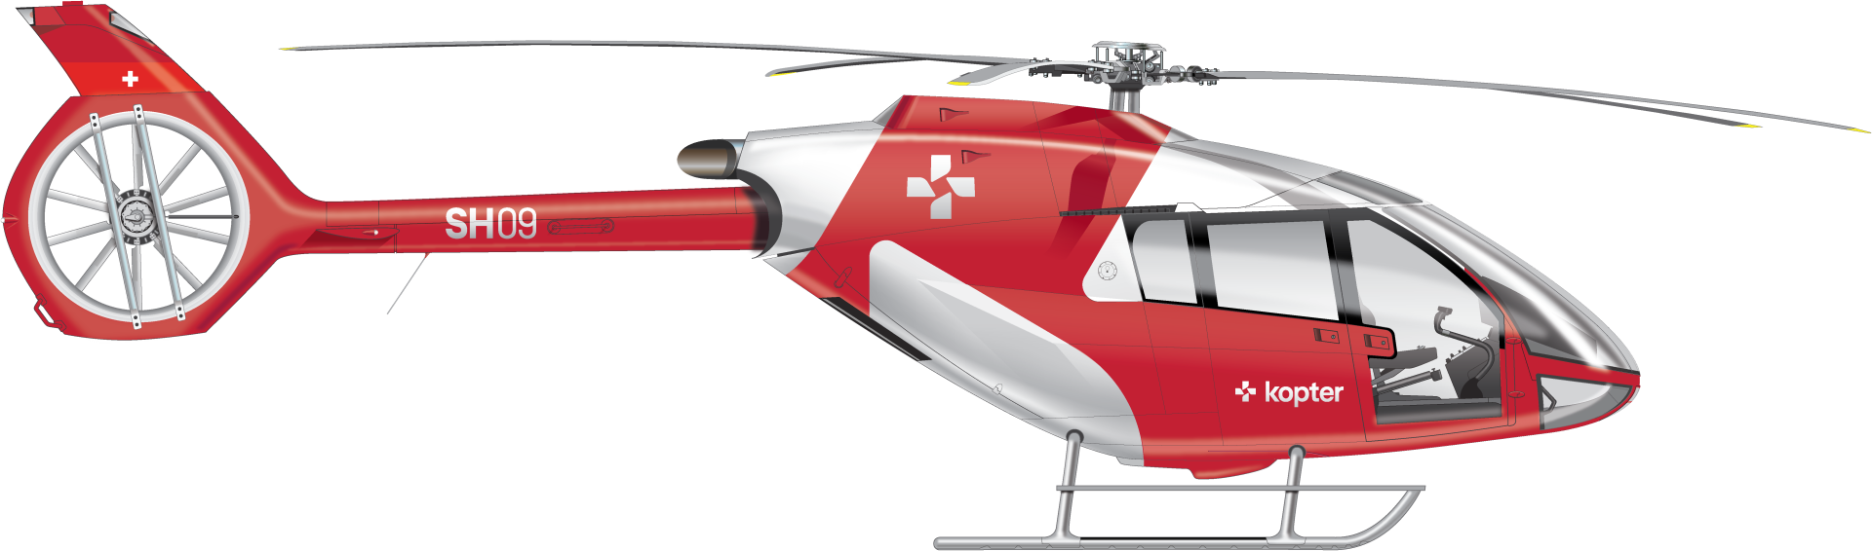
@ Kopter Group AG | Alejandro Valverde

Slide 18
Thank you

